Slide 1
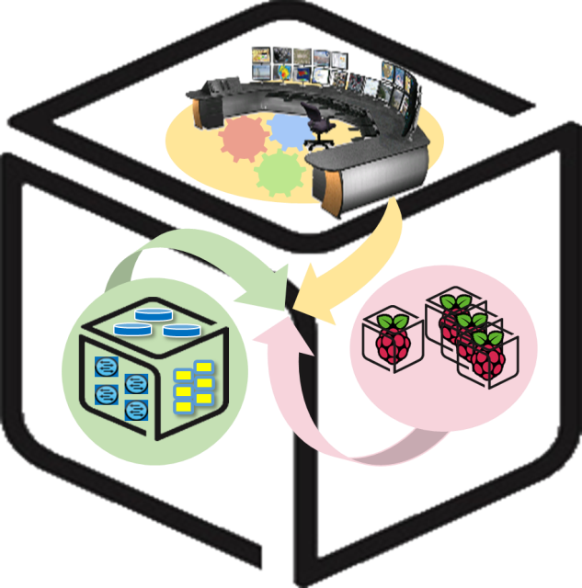



Computer Systems
For AI-inspired Cloud
Theory & Lab.
Lab #3.5: Tower 2
https://github.com/SmartX-Labs/SmartX-Mini-MOOC

Slide 2


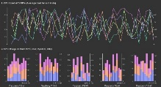





Tower Lab 2: Concept
Control Tower
Orchestration
Center
Provisioning
Center
Intelligence
Center
Visibility
Center
Docker Runtime
Linux Ubuntu OS

Slide 3








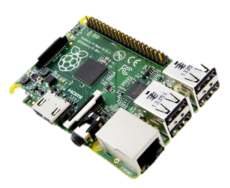
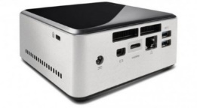
Control Tower
Orchestration
Center
Provisioning
Center
Intelligence
Center
Visibility
Center
Kafka broker cluster
Ubuntu Linux
Resource Topic
Resource Topic
SSH
Log
Sshlog Topic
SSH
Log
Sshlog Topic
Hypriot OS
Ubuntu Linux

Slide 4
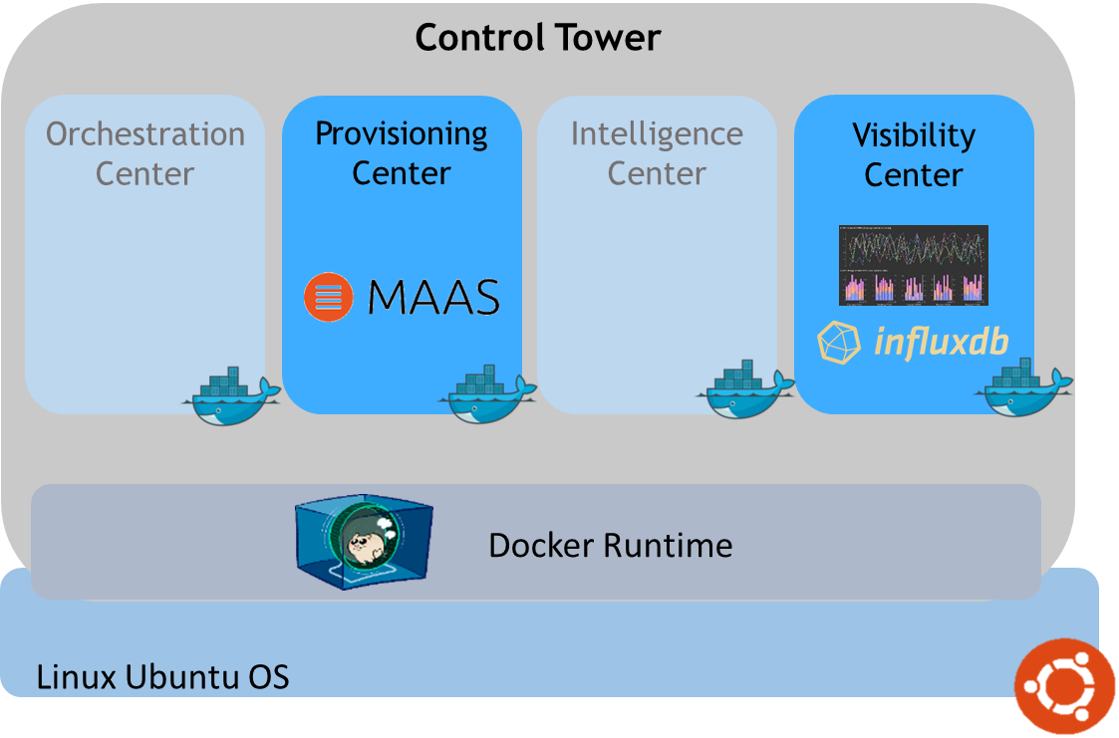


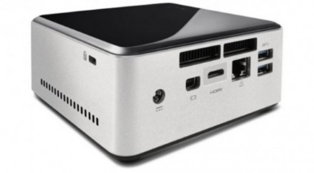


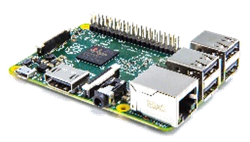



SmartX Labs #1~#3.5: Relationship
Tower Lab
Kafka broker cluster
Box Lab
VM
Tap1
br0
em1
Inter-Connect Lab
Hypriot OS

Slide 5



Theory

Slide 6
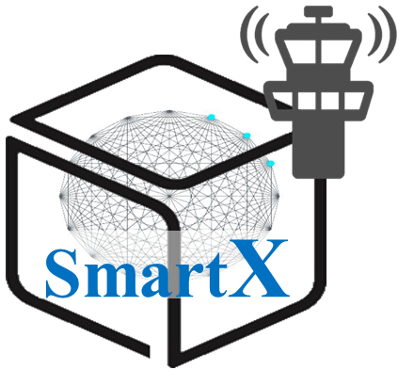
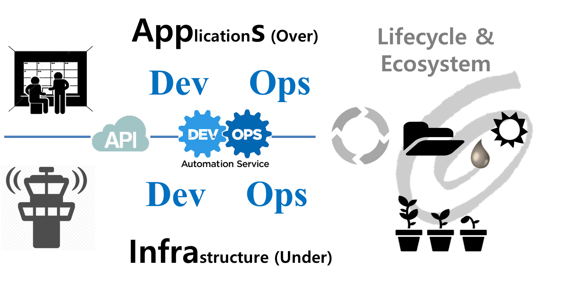
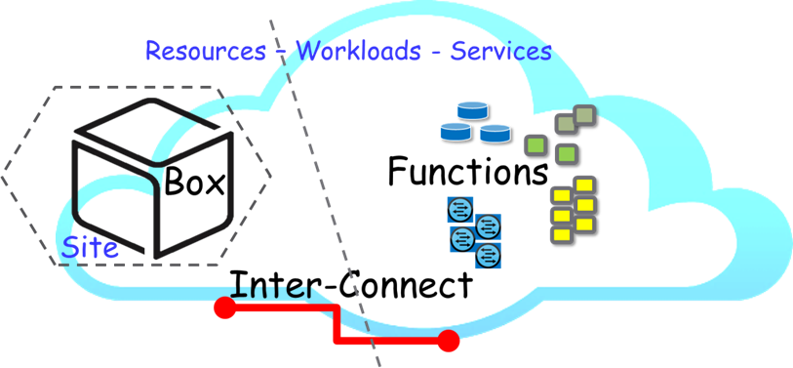
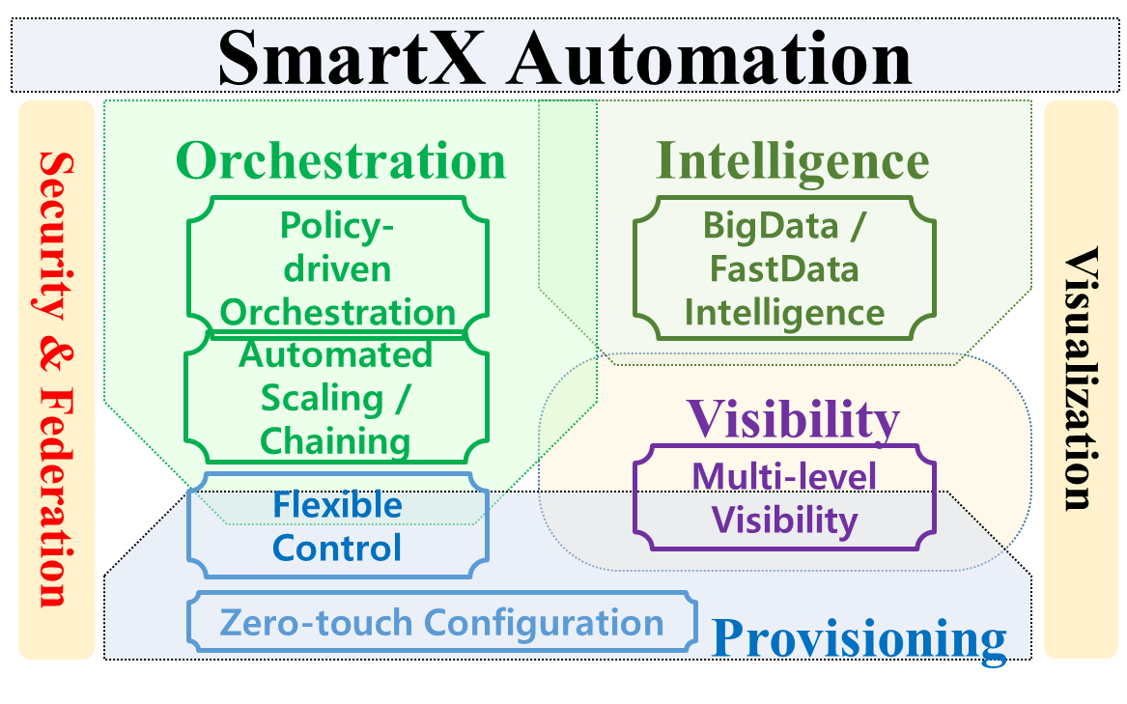
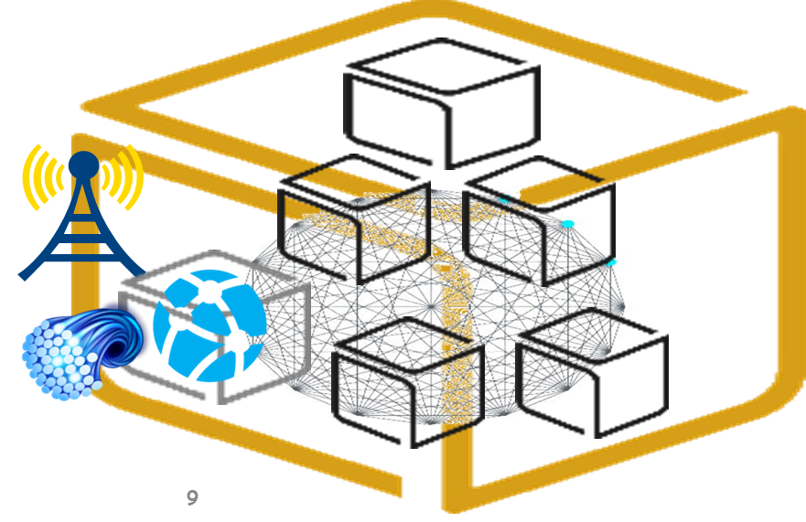
SmartX Automation Framework

Slide 7

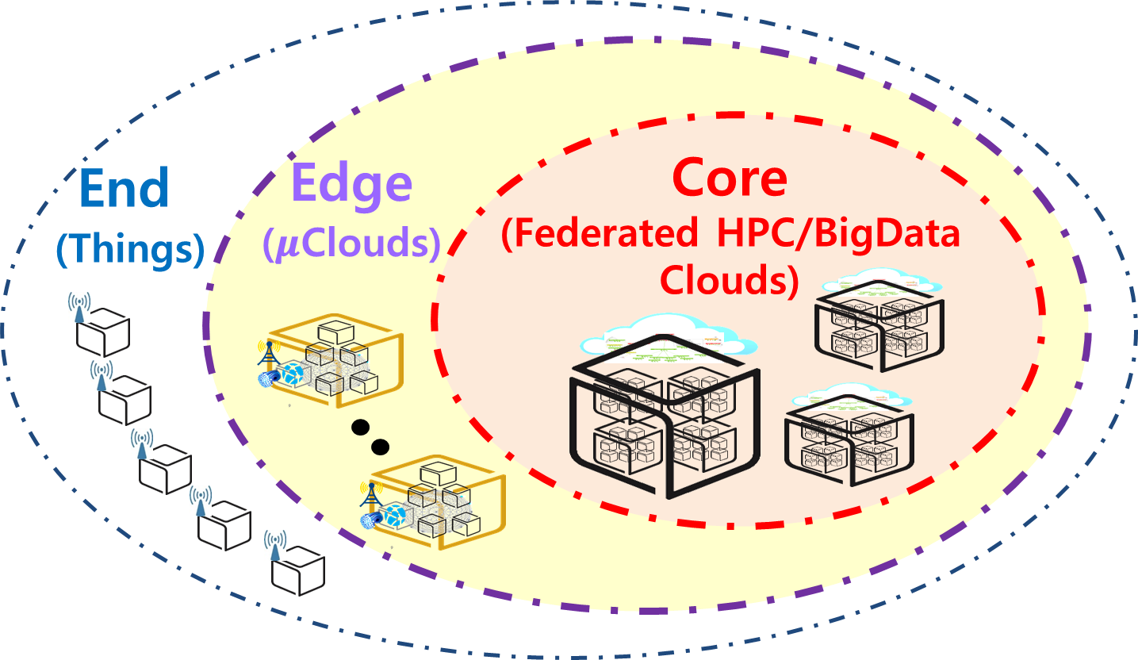
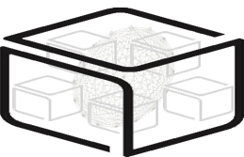



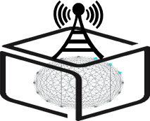
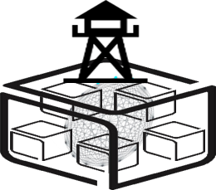
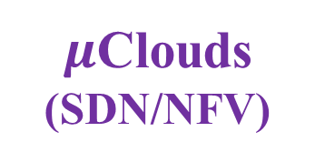
SmartX Composable Playground & Boxes
Type B/C
SmartX
Cloud Box
Type O
Type K/S
SmartX
DevOps Tower Cloud
with DataLake
SmartX
Edge μBoxes
SmartX
Edge Cluster
End
Edge
Core
Things
$μ$Clouds (SDN/NFV)
Clouds (HPC/BigData)

Slide 8

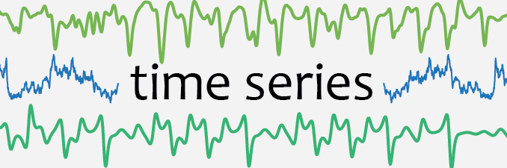

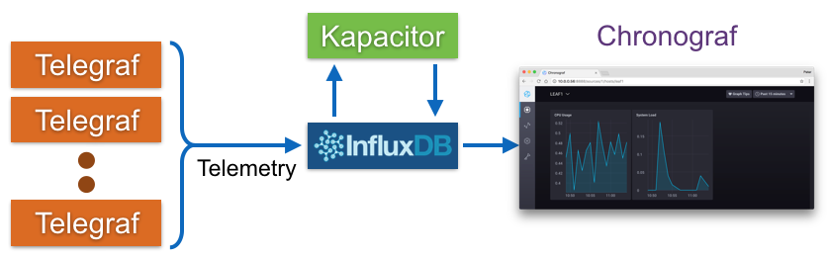
Visibility: TSDB (Time Series Database)
Time series data is arrays of numbers indexed by time.
In some fields these time series are called profiles, curves, or traces.

Slide 9
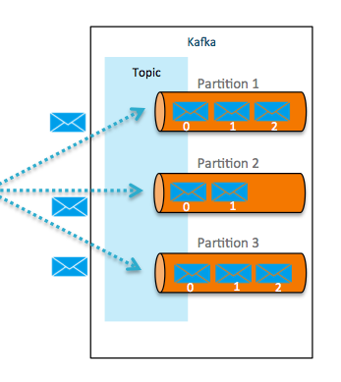
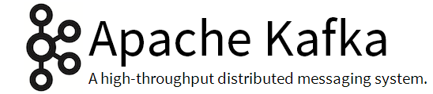




Orchestration: Apache Kafka
Kafka is a high-throughoutput distributed messaging system.
We can consume message at-most-once, at-least-once or exact-once.
ZooKeeper is a centralized service for maintaining configuration information, naming, providing distributed synchronization, and providing group services. Zookeeper is well used together with Kafka.
Many subprojects from Apache (especially big data projects including Hadoop) are taking logo originated from animals. ‘Zookeeper’ maintain and sustain connection between these projects(animals)
Animals
takes care of

Slide 10

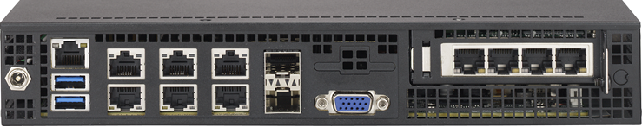

WAN through Tower - 1
SYS-E300-8D mini server
Raspberry PI
We can configure raspberry pi to connect to public internet through tower
The three essential techniques are needed: NAT, Masquerade, DHCP
NAT (Network Address Translation)
Exchange network traffic through routers while rewrite the TCP/UDP port number and source and destination of IP address
Masquerade
All network requests generated by internal computers are converted to external public IP address
DHCP(Dynamic Host Configuration Protocol)
Protocol that automatically provides the client with the IP address of the host and the basic setting of various TCP/IP Protocols

Slide 11

WAN through Tower – 2
Network Configuration
Use ‘dnsmasq’ DHCP deamon to provide DHCP server
Use linux command ‘iptables’ to modify NAT (Configure to provide Masquerade)
internet
eth0
172.72.xx.xxx
br0
eth5
eth0
192.168.50.100
eth1
eth2
eth3
eth4
Dnsmasq DHCP Server Configuration
Modify NAT
DHCP Client configuation
sudo apt-get install dnsmasq
sudo vi /etc/dnsmasq.conf
Sudo /etc/init.d/dnsmasq restart
sysctl –w net.ipv4.ip_forward=1
iptables –A FORWARD –i br0 –j ACCEPT
iptables –t nat –A POSTROUTING –o eth0 –j MASQERADE
sudo vi /etc/network/interfaces
sudo /etc/init.d/networking/restart
allow-hotplug
auto eth0
iface eth0 inet dhcp
Server=8.8.8.8
Bind-interfaces
Domain-needed
Bogus-priv
dhcp-range=interface:br0,192.168.50.81,192.168.50.99,12h
dhcp-option=3,192.168.50.100

Slide 12
Practice

Slide 13
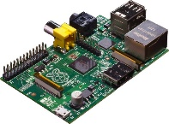


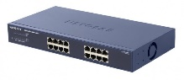
NAME: NUC5i5MYHE (NUC PC) CPU: i5-5300U @2.30GHz CORE: 4 Memory: 16GB DDR3 HDD: 94GB
#0 - Lab Preparation (1/1)
Wired connection
NAME: Raspberry Pi Model B (Pi) CPU: ARM Cortex A7 @900MHz CORE: 4 Memory: 1GB SD Card: 32GB
NAME: NT900X3A
CPU: i5-2537U @1.40GHz
CORE: 2 Memory: 4GB DDR3 HDD: 128GB
NAME: netgear prosafe 16 port gigabit switch(Switch) Network Ports: 16 auto-sensing 10/100/1000 Mbps Ethernet ports

Slide 14

#1 – Tower Setup (1/4)
- Docker installation (From Box Lab - ‘Making a Docker Container’)
Docker installation.
$sudo wget -qO- https://get.docker.com/ | sh
$sudo systemctl start docker
$sudo adduser [Your_account] docker
(Session restart)
$sudo docker run hello-world
reference: http://docs.docker.com/linux/step_one/
caution!
In the Tower, enter the IP and hostname of pi and NUC through
vi /etc/hosts command. (as well as pi and NUC)

Slide 15
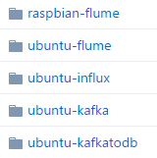
#1 – Tower Setup (2/4)
- Install & Run Kafka (From Inter-Connect Lab ‘Kafka deployment’)
Install git, vim, and nmap
$ apt-get install git vim nmap
Download all files from Github
(http://github.com/SmartXBox/SmartX-mini)
$ git clone https://github.com/SmartXBox/SmartX-mini.git
Folder List
In this section, we use this

Slide 16
#1 – Tower Setup (2/4)
- Install & Run Kafka (From Inter-Connect Lab ‘Kafka deployment’)
We’ll use a one zookeeper, 3 brokers and one consumer containers which share host’s public IP address
Zookeeper container doesn’t have broker id.
Each Broker has a unique id and port to interact each other.
Consumer container just used to manage topic and check the data from brokers.
Function(Container) Name | IP address | Broker id | Listening port
Zookeeper | Host’s public IP address | - | 2181
Kafka broker0 |  | 0 | 9090
Kafka broker1 |  | 1 | 9091
Kafka broker2 |  | 2 | 9092
Kafka consumer |  | - | -

Slide 17
#1 – Tower Setup (2/4)
- Install & Run Kafka (From Inter-Connect Lab ‘Kafka deployment’)
Build Docker Image
$ cd ~/SmartX-mini/ubuntu-kafka
Build Dockerfile ※ It takes long time. You should type ‘.’ !
$ docker build --tag ubuntu-kafka .
If you want to check Docker instruction words
$ docker --help
ex) docker ps : List containers
docker start : Start one or more stopped containers
docker rm : Remove one or more containers

Slide 18
#1 – Tower Setup (2/4)
- Install & Run Kafka (From Inter-Connect Lab ‘Kafka deployment’)
Run Docker Container
$ docker run -it --net=host --name [container name] ubuntu-kafka
We need to run 5 containers (zookeeper 1, broker 3, consumer 1)
Let’s assume the name of each containers,
zookeeper, broker0, broker1, broker2, consumer
Repeatedly type the above command with changing container name
If you want to look for more details about Docker command, see https://docs.docker.com/reference/commandline/

Slide 19
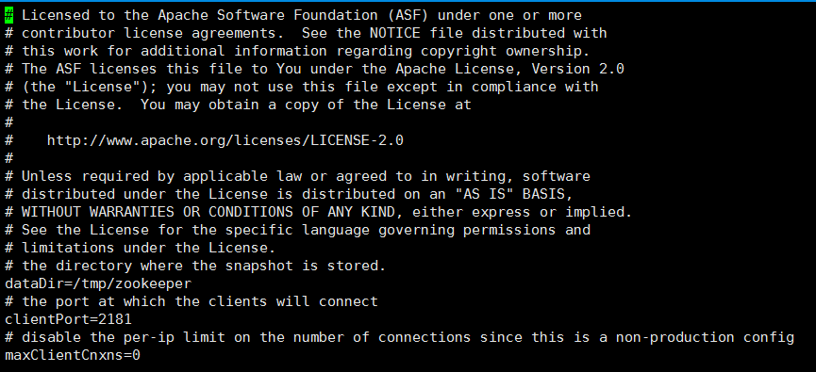
#1 – Tower Setup (2/4)
- Install & Run Kafka (From Inter-Connect Lab ‘Kafka Containers’)
Actually we use default configuration
Open zookeeper properties file
$ vi config/zookeeper.properties
Check the client port

Slide 20
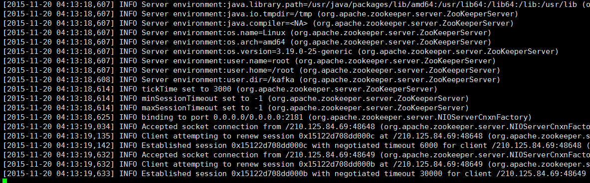
#1 – Tower Setup (2/4)
- Install & Run Kafka (From Inter-Connect Lab ‘Kafka Containers’)
zookeeper must be executed FIRST
$ bin/zookeeper-server-start.sh config/zookeeper.properties
(Leave Zookeeper running and open a new terminal for next tasks)

Slide 21
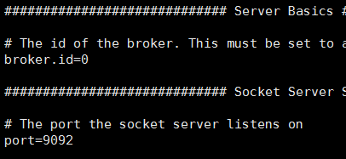
#1 – Tower Setup (2/4)
- Install & Run Kafka (From Inter-Connect Lab ‘Kafka Containers’)
Create a Kafka container with the docker command before
$ docker run -it --net=host --name [container name] ubuntu-kafka
Open server properties file and change proper broker id and port (they must be unique to each other) (Only for broker0,1,2)
$ vi config/server.properties
Container Name | Broker id | Listening port
broker0 | 0 | 9090
broker1 | 1 | 9091
broker2 | 2 | 9092
consumer | - | -
broker id
port
Consumer container will not run any brokers

Slide 22
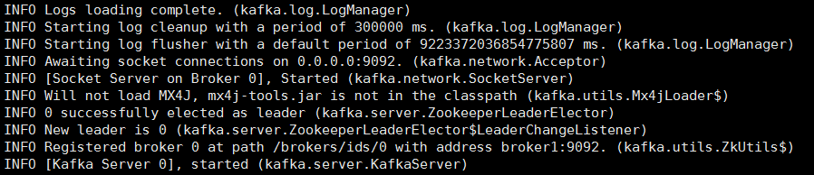
#1 – Tower Setup (2/4)
- Install & Run Kafka (From Inter-Connect Lab ‘Kafka Containers’)
Execute Kafka brokers (Only for broker0,1,2)
$ bin/kafka-server-start.sh config/server.properties
Repeat previous steps for broker0, broker1, broker2, consumer
When it successfully works, each broker containers will show messages like the below

Slide 23
#1 – Tower Setup (2/4)
- Install & Run Kafka
Create topic
$ bin/kafka-topics.sh --create --zookeeper localhost:2181 --replication-factor 1 --partitions 3 --topic resource
$ bin/kafka-topics.sh --create --zookeeper localhost:2181 --replication-factor 1 --partitions 3 --topic sshlog
We can check topics.
Topic List
$ bin/kafka-topics.sh --list --zookeeper localhost:2181
Topic specification
$ bin/kafka-topics.sh --describe --zookeeper localhost:2181 --topic resource
resource

Slide 24
#1 – Tower Setup (3/4)
- Install & Run InfluxDB & Chronograf (From Tower Lab ‘Run InfluxDB & Chronograf Containers on NUC)
Run InfluxDB Container
$ docker run -d --name=influxdb --net=host influxdb
Make and run Chronograf container
$ docker run -p 8888:8888 --net=host chronograf --influxdb-url=http://<TOWER IP>:8086

Slide 25
#1 – Tower Setup (3/4)
- Install & Run InfluxDB & Chronograf (From Tower Lab ‘Run InfluxDB & Chronograf Containers on NUC)
Install python-pip
$ sudo apt-get install -y libcurl3 openssl curl
$ sudo apt-get install -y python2.7 python-pip
$ sudo apt-get install –y python3-pip
Install python package
$ sudo pip install requests
$ sudo pip install kafka-python
$ sudo pip install influxdb
$ sudo pip install msgpack

Slide 26
#1 – Tower Setup (4/4)
- Send broker message to influxDB (in Tower)
Start new terminal
Download python script file (INSIDE the container) wget -O broker_to_influxdb.py https://raw.githubusercontent.com/ yd8012mw2/SmartXLab_FileHost/master/broker_to_influxdb.py
Edit File
Run python script file python broker_to_influxdb.py
(No space/new line)
To Tower IP

Slide 27
#1 – Tower Setup (4/4)
- Install simple management dashboard
Start new terminal
Clone the project from github git clone https://github.com/yd8012mw2/GIST_TOWER2
Move to project directory cd GIST_TOWER2
Install packages pip3 install -r requirements.txt
Move to tower2 folder cd tower2

Slide 28
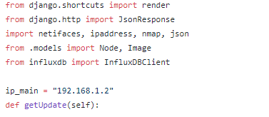
#1 – Tower Setup (4/4)
- Install simple management dashboard
Edit views.py (towersite/views.py) vi towersite/views.py
Change to the tower’s ip

Slide 29
#2 – NUC Setup
- Install SNMP package for NUC (From InterConnect Lab ‘Net-SNMP installation’)
Update packages
$ sudo apt update
Download Net-SNMP
$ sudo apt install –y snmp snmpd snmp-mibs-downloader
Download MIBs
$ sudo download-mibs
Modify configuration file
$ sudo vi /etc/snmp/snmpd.conf
#rocommunity public localhost -> Delete #
$ sudo systemctl restart snmpd.service

Slide 30
#2 – NUC Setup
- Install flume package for NUC
Go to SmartX-mini/ubuntu-flume directory cd ~/SmartX-mini/ubuntu-flume
Build flume container docker build --tag ubuntu-flume .
(Put punctuation mark at the end of the command)

Slide 31
#3 – Box Setup
- Edit flume configuration
Add tower ip and tower computer name at the end of file ‘/etc/hosts’
Build flume container In case of NUC docker run -it --net=host --name flume2 -v /var/log/auth.log:/var/log/auth.log:ro ubuntu-flume In case of Raspberry Pi docker run -it --net=host --name flume2 -v /var/log/auth.log:/var/log/auth.log:ro raspbian-flume

Slide 32
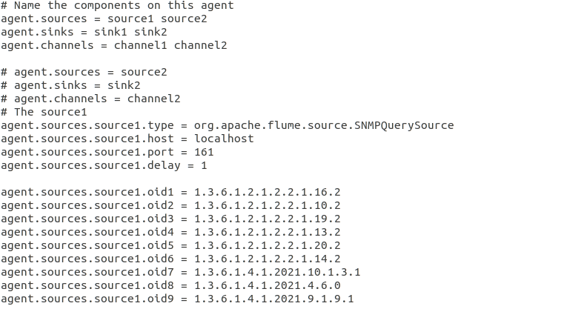
#3 – Box Setup
- Edit flume configuration
Edit flume configuration docker start flume2 docker attach flume2 vi conf/flume-conf.properties
You should change the content here
You should NOT
change the content here

Slide 33
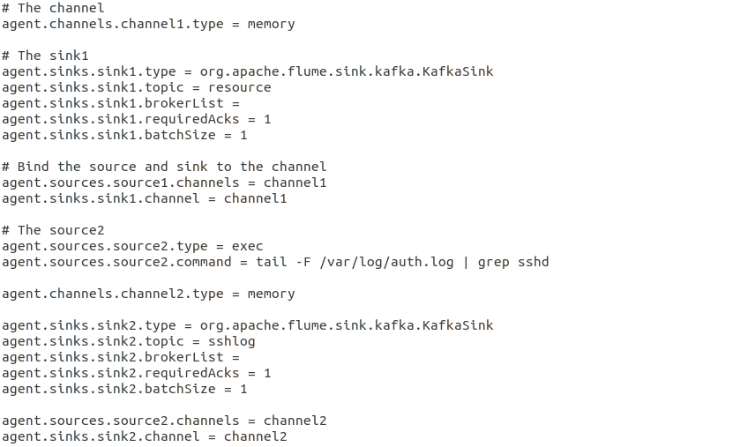
#3 – Box Setup
- Edit flume configuration
Edit flume configuration docker start flume2 docker attach flume2 vi conf/flume-conf.properties
You should NOT
change the content here
tower:9090,tower:9091,tower:9092
Change the broker ip to tower
You should NOT
change the content here
You should ADD
the content here
tower:9090,tower:9091,tower:9092
Put your tower’s computer name

Slide 34
#3 – Box Setup
- Edit flume configuration
Run Flume on Raspberry Pi and NUC
$ bin/flume-ng agent --conf conf --conf-file conf/flume-conf.properties --name agent -Dflume.root.logger=INFO,console

Slide 35
#4 – Dashboard Management
- Run simple management dashboard
Check Database migration python3 manage.py makemigrations python3 manage.py migrate
Run server python3 manage.py runserver 0.0.0.0:8000
Start the web browser and open ‘localhost:8000’
When the IP of the django server in the Tower and the environment using the web browser are different, you have to edit ~/GIST_TOWER2/tower2/tower2/settings.py to access the server.
ALLOWED_HOST = [] -> ALLOWED_HOST = ['*'] (28th line)
caution!

Slide 36
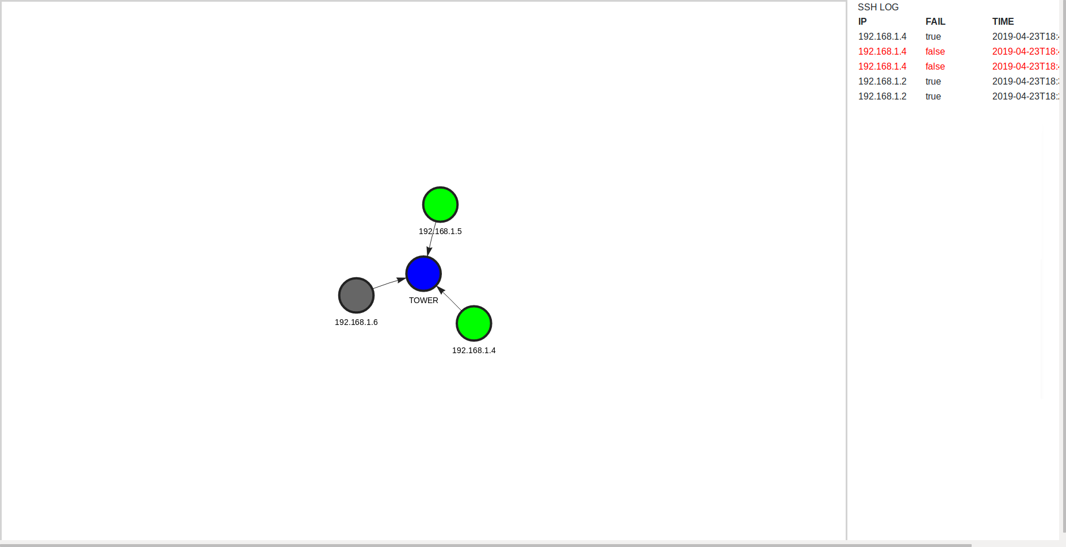
#4 – Dashboard Management
- Run simple management dashboard
Sample images

Slide 37
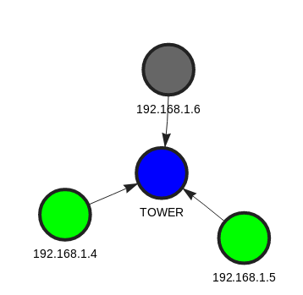
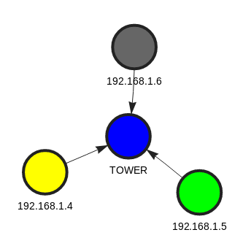
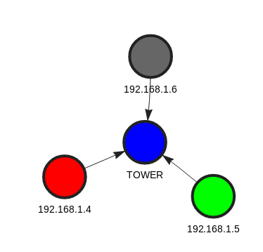
#4 – Dashboard Management
- Run simple management dashboard
Sample images
CPU Usage : Low
CPU Usage : Moderate
CPU Usage : Excessive

Slide 38
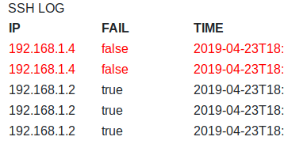
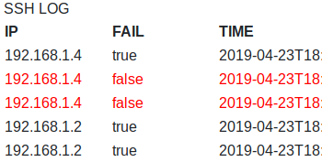
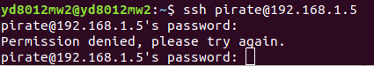
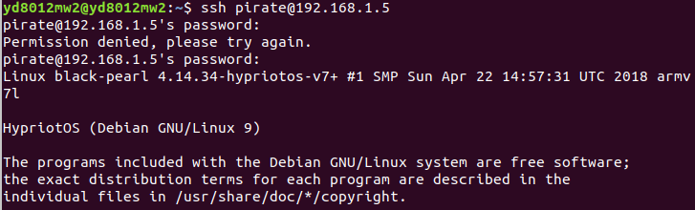
#4 – Dashboard Management
- Run simple management dashboard
Sample images
If SSH Login fails
If SSH Login succeeds

Slide 39
#4 – Dashboard Management
- Run simple management dashboard
Stress computer (Not recommended for Raspberry Pi) apt-get install stress stress --cpu 4

Slide 40
Review

Slide 41
Lab Summary
With Tower Lab, you have experimented selected roles of Monitor/Control (관제) Tower
Visibility Center function to enable ‘distributed monitoring’ over remote Boxes and to store ‘monitoring information’ to time-size DB.
Provisioning Center function to enable remote ‘installation & configuration (of OS and others)’ of distributed Boxes.

Slide 42
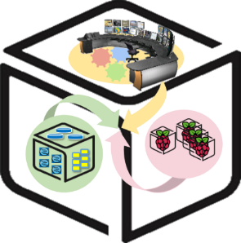
Thank You for Your Attention
Any Questions?
mini@smartx.kr

